Slide 1
THE BIG DATA IN BUISNESS

Slide 2
Content
1.About us.
2.Our Problem
3.Our solution.
3-1.Benefits.
3-2.Features.
3-3.Description.
3-3.Clients.
4.Marketing.
4-1.Companies that use it.
4-2.Client Options
-cloud
-own server
-rented
5.Future Dev
5-1 inner infrastructure
5-2 Additional Features

Slide 3
ABOUT US
Our team consists of 5 people total:
Atanas Angelov Ninov
Boris Krasimirov Aladzhov
Stefan Veselinov Vasilev
Sofroni Petkov Nenov
Natali Zhoro Atanasova
We are students from the Technical University of Sofia. From the Faculty of

Slide 4
2.Our Problem
With the advancements and constant need for expansion
of data bases the companies that use the most amount of
data in them tend to find such things quite difficult to
achieve. We though that by trafficking their data into a
newer model by keeping the data and structure the
same we can allow for easier expansion and work on it.

Slide 5
3.OUR SOLUTION
Our main solution was to use the open source database management system ClickHouse. With it being open source and with the help of one of our teammates we managed to use it to transfer the data from a simple sql database into ClickHouse with extraordinary results.
3-1.Benefits
With our product we can provided our clients with a very secure transfer of their databases into a newer data model with (possibly) minimal loss of the original data. This endeavour will allow the clients to not only utilize their costs in a better way by allowing them to manage and expand their database without any slowing down and higly increase the speed and performance.

Slide 6
3-2.Features
The transfer of data into ClickHouse makes it far more easier to use and expand then what other data models offer. ClickHouse is exponentially faster than older data bases with lower data loss in transfer and better scalability.
Using our method we can provide long lasting use of your data with easy to expand upon the clients needs or wants.
When updating or transferring data the downtime is a lot lower then what is offered by older style databases.

Slide 7
3-3.Description
Some benefits that come from our services not only allow us to make for easy costs utilization by allowing our clients to lower the need of their own data base support but to expand upon even the smallest need that they inquire about . That could be for example wanting to keep high transfer speed and to expand the size of the data base without any losses which we could provide with the help of the cloud.
The reason any client that might want to use our services is to allow themselves to not have to worry and invest resources to hire a team of their own and train them to work on a database and risk the results not being on par with their wishes . Exporting the work to an outside vendor like us could be beneficial to them when they only have to focus on their main work effort.

Slide 8
3-4.Clients
The type of clients that might be intrigued by our services are usually in the spheres of software
development , technical consulting , real time analytics and ai advancement. Their large and
everchanging databases require a lot of maintenance and work upon them to allow for expansion
which with our help can not only be easily done but also at a great mark up for the clients.

Slide 9
Marketing
The biggest example that’s quite easy to give nowadays is the problems with data transfer from the chat gpt database. Most believe that it is due to networking but the truth is that its data base is quite slow due to the large amount of requests in it. If chat gpt were to employ our services we could not only increase the transfer speed and user experience but it might motivate users to go premium for the program increasing revinue.

Slide 10
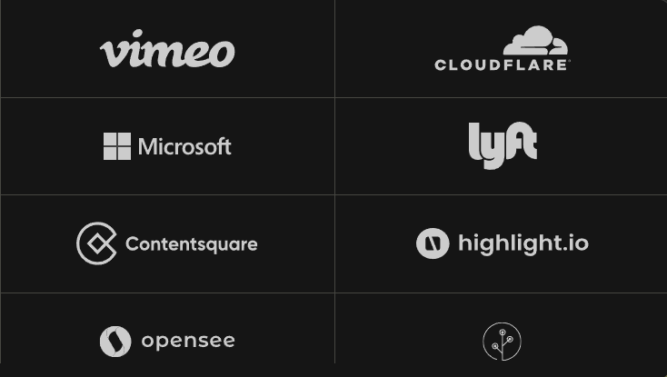
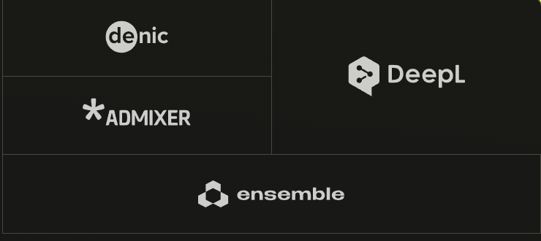
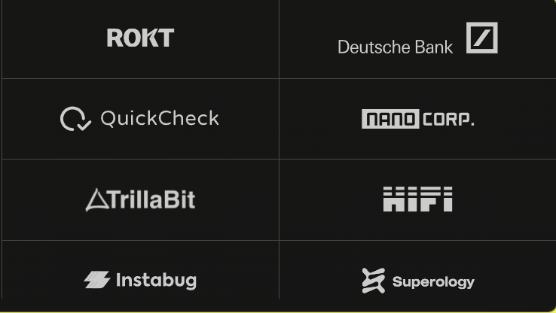
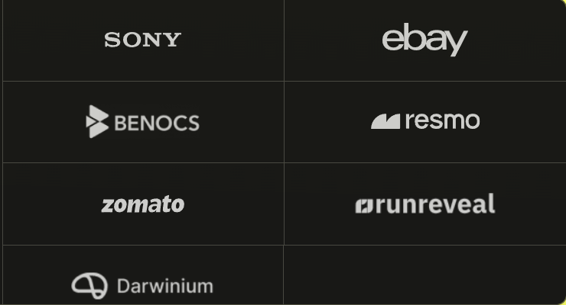
Companies that are using it
Most of the companies that you are seeing are
already using ClickHouse as a method to do
real-time Analytics , keep logs, events and traces,
, to increase business intelligence and to
Advance machine learning and GenAI.

Slide 11
Client Options
Showing what the client can use it for
Like server cloud and their own servers

Slide 12
Demo
For the demo of how it works we will now show you the videos.

Slide 13
Inner infrastructure
Future Dev
We will need to develop a way for the clients to easily
access our services and to create a database in which we
can store our clients moderative accounts and their levels
of access.

Slide 14
Future Features
Possible future features can be:
1.Data Analysis
2.
3.
4.

Slide 15
Thank you for being with us
Any questions?

